Slide 1

KLEEM CARE
Kleem Care India Pvt Ltd was established in the year 2020. We provide treatment to restore, maintain and make the most of a patient's mobility, function and well-being. We get you involved in your own recovery.

Slide 2
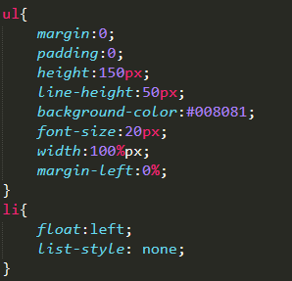
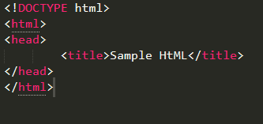
Requirements:-
HTML
CSS
HTML:- HTML stands for “Hyper Text
Markup Language ”. It is the
standard markup language for
creating web pages.
CSS:- CSS stands for
“Cascading Style Sheets”
CSS describes how HTML
elements are to be displayed
on screen , paper or in other
media.

Slide 3
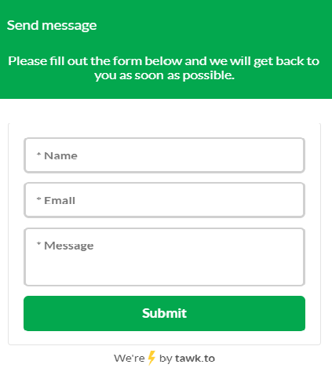
We have developed our website “KLEEM CARE” using HTML, CSS and Media Query. We also have implemented “ Chat Box “ in our website using “twak.to”. Chat box is used to get feedback
from site visitors regarding the services.

Slide 4
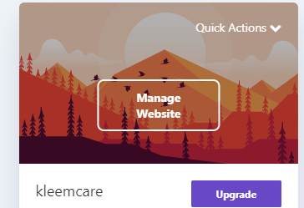
Hosting on 000webhost :-
000WebHost are a FREE web hosting company, powered by Hostinger. They offer web hosting at no cost with a 99.9% uptime guarantee. ... Zero cost website hosting with PHP, MySQL, cPanel & no ads!
Steps :-
->Create account on “000Webhost”
->Create a project (give project name)
->Now click on manage website.
->Now Dashboard opens.. Click on “File Manager”, And then “upload files”.

Slide 5
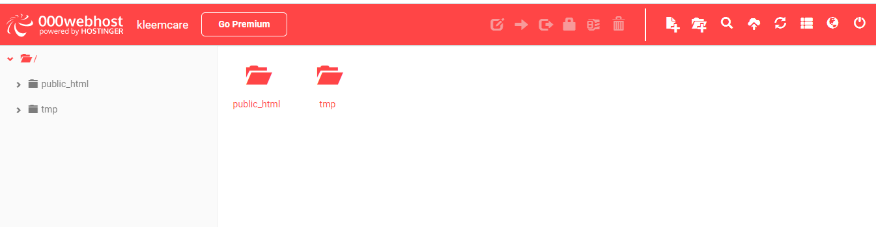

-> Here we are uploading our project files such as html file, css file, images etc.
->double click on “public_html” and here upload the files.
Now your website is hosted.

Slide 6
How to point a domain to 000webhost ?
Steps :-
The first thing you need to do is to change your domain’s nameservers to ns01.000webhost.com and ns02.000webhost.com.
Steps after domain nameservers are changed:
Park domain in 000webhost panel. Go to Set web address -> Add domain -> Park domain
Enter your domain name and click Park domain
If your nameservers are pointed correctly to 000webhost nameservers, domain will show status Ready which means that is ready to link Website.
Click Manage -> Link website.

Slide 7
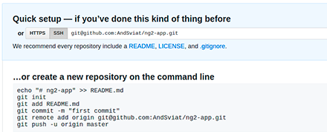
Hosting on github :-
GitHub is a code hosting platform for version control and collaboration. It lets you and others work together on projects from anywhere.
Git is a command line tool
Steps to host website on github :-
Create a account on github.
Download and install the GitHub Desktop app. This is the app that we'll use to get our code up on GitHub.
Create a new repository.
Copy your files to the new Repository folder.

Slide 8
Goto settings and select “Git Pages” . There is a option from this
select “master branch” and save. Now again goto “github pages” you will see
a link, right click on it and open it in new tab.
This is how you host your website on github.
Share your website!
Steps to add custom domain name :-
Login to use account from where you purchased domain.
Goto DNS management system. And select “manage DNS”.
In this add “A record” , Before this goto your github . It has 4 custom domain
IP’s , add all IP’s to A record.
Now goto your github repository and goto root directory.
Here you have to create 1 extra file , click on create new file and file name as
“CNAME”.
In the first line give your url. (Ex: 1. Kleemcare.com)
Click on “commit new file”. Now you can check it.
none

Slide 9
Hosting on Google Firebase:-
->Firstly download and install node.js .
->Then go to Firebase website and create a new project,
by specifying the project name.
For Firebase Installation:-
-> In command prompt window ,type: “npm install –g firebase-tools” this line will
install all firebase-tools.
For Firebase Login:-
->In command prompt window , type: “firebase login” then allow firebase to collect
information by pressing ‘Y’(yes) now it will redirect to browser for login….
select the account ,sign in, and allow “Firebase CLI” .

Slide 10
For Firebase Initialization:-
->In Command prompt window, type:- “Firebase init” then press ‘Y’ to proceed
the select “Hosting option”.
-> For project setup, select project and hit enter. Then add project folder by specifying
the folder name.
-> For publishing the website type:- “Firebase deploy” and finally our website has
successfully hosted on firebase.

Slide 11
Problems :-
We are facing problem in adding ssl certificate.
We are facing problems in adding web security to our website using cloudflare.

